Slide 1
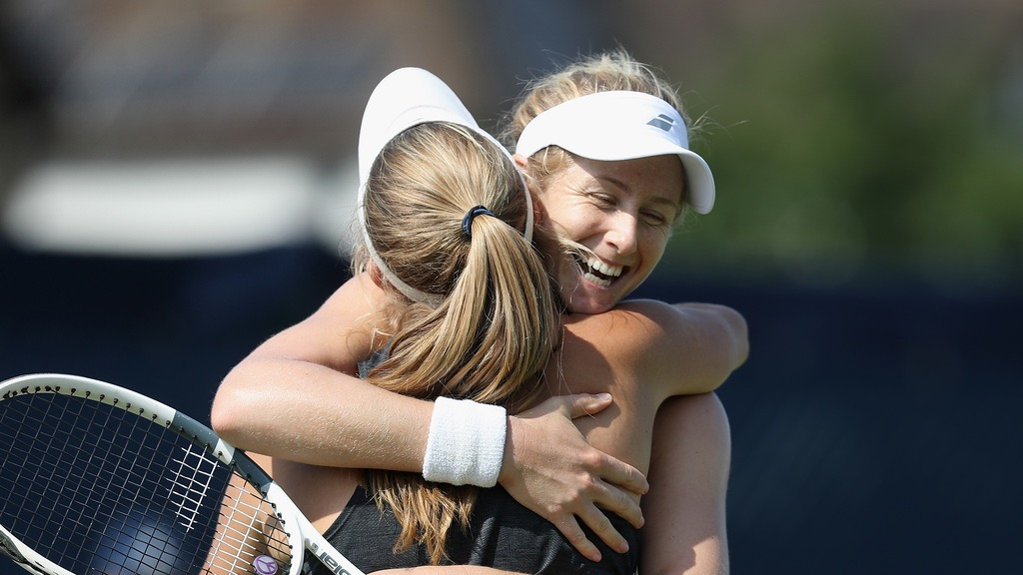

PERSONAL CHALLENGE
“
WORK HARD TO GET GOOD, THEN WORK HARDER TO GET BETTER.
Roger Federer
“
Notes:
Players shown in the image are Ellen Perez and Jessica Moore of Australia, who are doubles partners.
Roger Federer is a Swiss tennis player who is one of the best known players in the world. He holds the record for winning the most Grand Slam men’s singles titles (20), and has been in over 30 finals. He was number one in the world for 302 weeks, becoming number one at the record oldest age of 36. He has won the men’s singles eight times at Wimbledon, which is the record for most Wimbledon Championships won. He earned a doubles Olympic gold medal at Beijing 2008, and a singles Olympic silver medal at London 2012 (against Andy Murray).

Slide 2
INTRODUCTION FOR PARENTS & CARERS (1)
DEVELOPING CHARACTER QUALITIES THROUGH TENNIS
The LTA Youth Schools programme is a suite of resources developed by the LTA to inspire the next generation of players and fans. These personal development activities were originally designed for teaching in lessons such as Personal, Social, Health and Economic (PSHE) Education, but have been adapted to support home learning.
This resource from the LTA gives children and their families information and activities to help them develop qualities and skills for personal development through five tennis-related challenges. The key character qualities are: resilience (which includes bouncing back); perseverance; motivation; passion (including enthusiasm) and respect. The challenges are designed for children in Key Stage 2 (Years 3-6) (Scotland: P4-7).
DEFINING THE KEY CHARACTER QUALITIES
Here are some ways to define the key character qualities. Children might have their own understanding of them too, especially after they have done the challenges:
Resilience: when you can ‘bounce back’ and get through something which has been difficult, or made you unhappy.
Perseverance: when you keep on trying at something and don’t give up.
Motivation: doing something because you want to, not because you are told to.
Passion: you have a very strong interest in something – you are excited and enthusiastic about it; you really love it!
Respect: thinking about how what you do or say might affect others; listening and appreciating who they are / what they do.

Slide 3
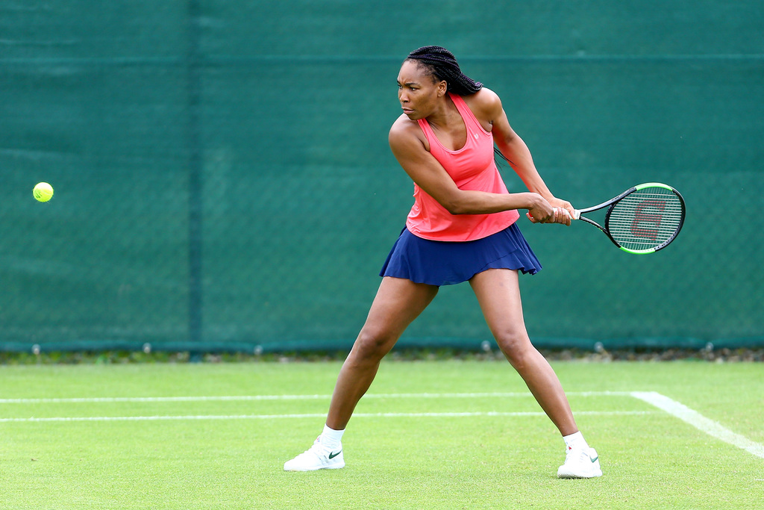
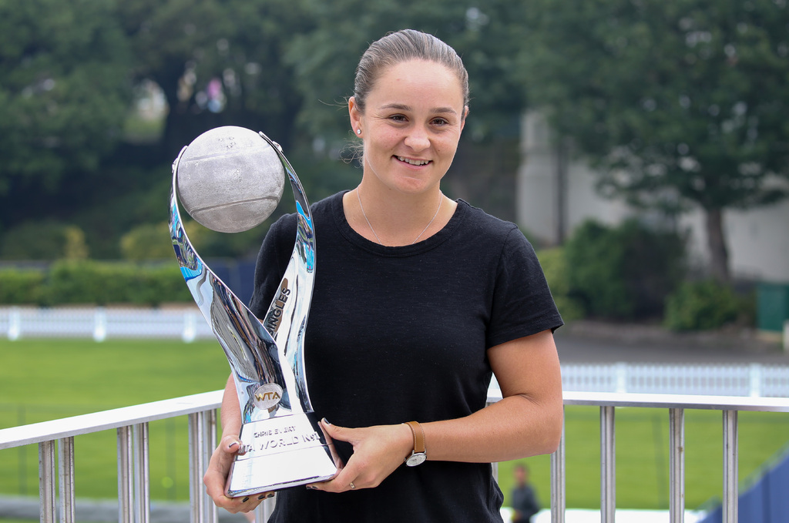
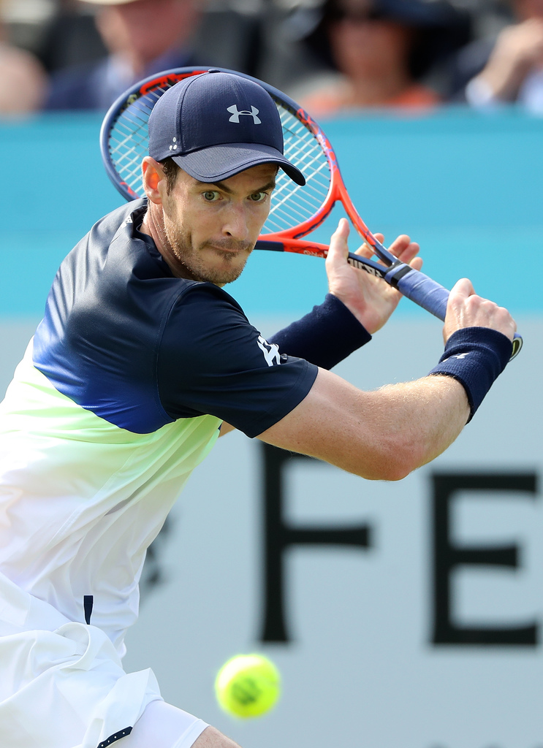
INTRODUCTION FOR PARENTS & CARERS (2)
COMPLETING THE CHALLENGES
First, look at the introductory presentation which sets the scene for the challenges, including the films. This will give you some useful background information about tennis, and about the key physical and character qualities which tennis players need.
You can do the five challenges whenever you want to, inside your home or in an outside space if you have one. For example, you might choose to do one a day for a week.
The challenges have been designed so that ideally, families can work through the activities together. However, children can also use them independently.
You don’t need any special equipment – some challenges need no equipment at all; others only whatever you can find around the home. Ideas are provided if you want to make the challenges harder, or you can think of your own
ways to take them further.
Each challenge focuses on one key character quality; however, children are encouraged to think about the other qualities which they might be using too. If doing
the challenges with other people, at the end of each
one there is the chance to ‘award’ someone who best demonstrated a key quality.
There is also this final ‘personal challenge’ which encourages children to develop a skill over the course of a week.

Slide 4

WARM-UP
Get started:
Make a list of all the things you do on an ordinary day.
Can you work out how much time everything takes? How much time do you have left over?
Is there anything you do regularly every day to get better at it?
Today’s quality is: ALL OF THEM!
One thing that tennis players do is to practise and practise to be the best they can be. They don’t just do something once; they repeat and repeat skills, actions and routines over and over again to become fitter and more skilful.

Slide 5
YOUR PERSONAL CHALLENGE
Instructions
Choose a skill that you want to learn or practise. You could use equipment like a tennis ball or racket, or just a ball, or even your hands and feet. The skill could involve hitting, running, bouncing… something you would like to get better at.
Write down or draw the skill you want to improve. How many times can you do the action at the moment? How many times can you repeat the action in a specific time? How many times would you like to be able to do?
Practise the skill for at least 10 minutes every day for a week. Remember – the more you practise the more you will improve!
At the end of the week, repeat the activity. Have you got better at it? Have you reached your target number of times? What could you get better at next?
Tips and ideas
If you have a tennis (or any other) ball you could use that, and a racket or bat if you have one. If you don’t have a racket you could use your hands. If you don’t have a ball use something round, or practice running, jumping, hopping or even skipping skills.
Here are some skill ideas:
Tap ups; tap downs
Tap up and down using a racket, bat or hands
Hit a ball against a wall continuously: with groundstrokes (it bounces); with volleys
(no bounce); with both!
Throw and catch against a wall; in the air
Bounce or hit a ball to someone else
If you have space, time how long it takes
to sprint from one place to another

Slide 6
YOUR PERSONAL CHALLENGE
When you’ve tried the challenge think about:
What helped you?
What didn’t help you?
How could you get better?
Which challenge could you do next?
Make the challenge harder!
Challenge yourself to go further with your skill each time; give yourself a new challenge to complete.
Can you do more?
Can you do it quicker?
Can you set yourself a goal and reach it within a week? Two weeks? A month?
What is the highest number of times/fastest time you would like to be able to do your challenge? How long will you need to succeed?

Slide 7
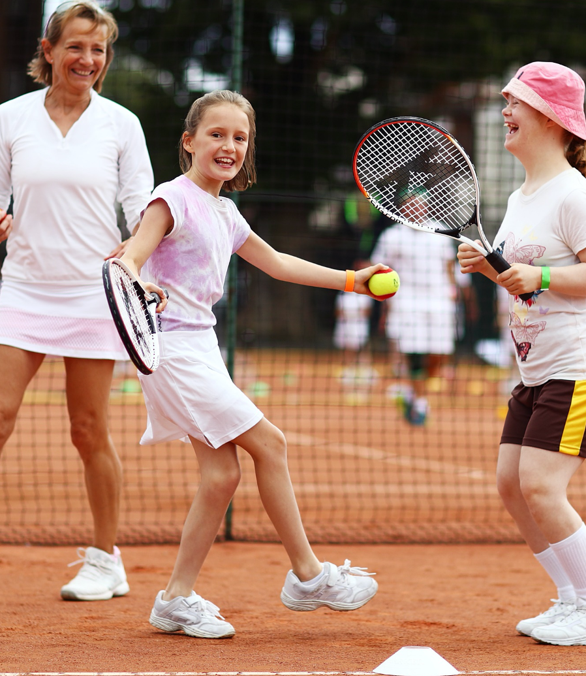
AND THE AWARD GOES TO… YOU!
Ask yourself…
How well did I do?
Could I do even better?
And the award goes to…
Award yourself for persevering and getting better at your challenge!
Which other character qualities did you demonstrate?
Afterwards…
Congratulate yourself for achieving your goal!
Why not complete the player biography sheet? What is your strongest character quality?

