Slide 1
TENNIS AT HOME
Personal development challenge 2

Slide 2
INTRODUCTION FOR PARENTS & CARERS (1)
DEVELOPING CHARACTER QUALITIES THROUGH TENNIS
The LTA Youth Schools programme is a suite of resources developed by the LTA to inspire the next generation of players and fans. These personal development activities were originally designed for teaching in lessons such as Personal, Social, Health and Economic (PSHE) Education, but have been adapted to support home learning.
This resource from the LTA gives children and their families information and activities to help them develop qualities and skills for personal development through five tennis-related challenges. The key character qualities are: resilience (which includes bouncing back); perseverance; motivation; passion (including enthusiasm) and respect. The challenges are designed for children in Key Stage 2 (Years 3-6) (Scotland: P4-7).
DEFINING THE KEY CHARACTER QUALITIES
Here are some ways to define the key character qualities. Children might have their own understanding of them too, especially after they have done the challenges:
Resilience: when you can ‘bounce back’ and get through something which has been difficult, or made you unhappy.
Perseverance: when you keep on trying at something and don’t give up.
Motivation: doing something because you want to, not because you are told to.
Passion: you have a very strong interest in something – you are excited and enthusiastic about it; you really love it!
Respect: thinking about how what you do or say might affect others; listening and appreciating who they are / what they do.

Slide 3
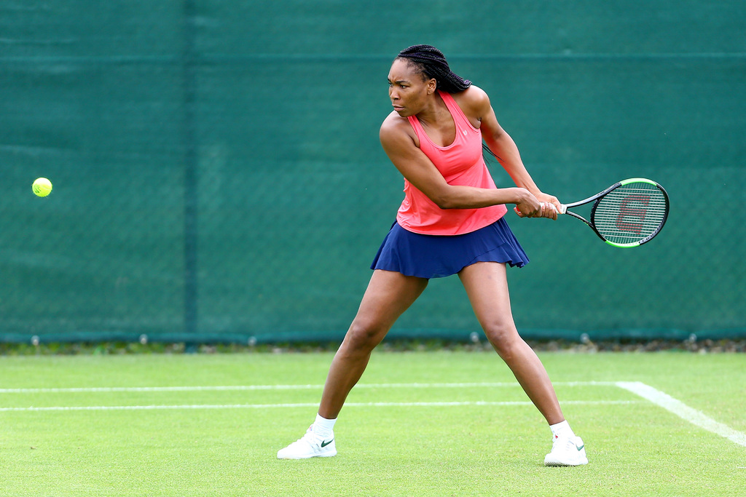
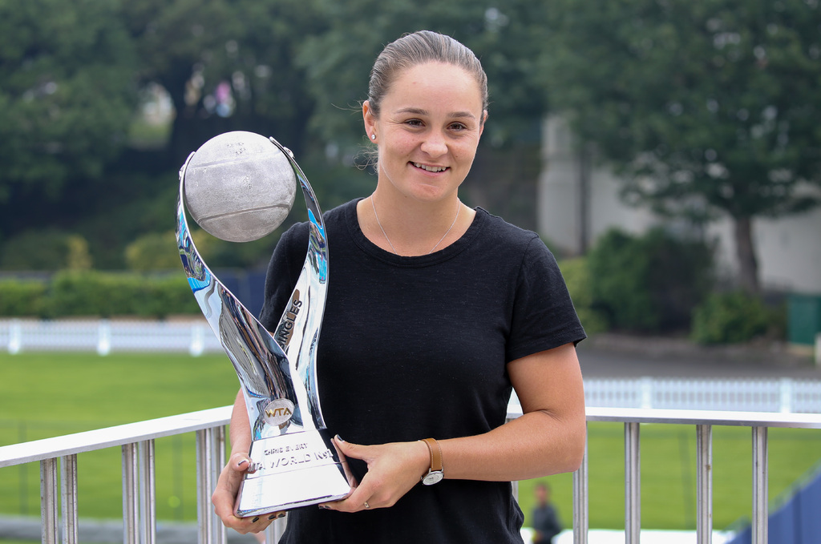
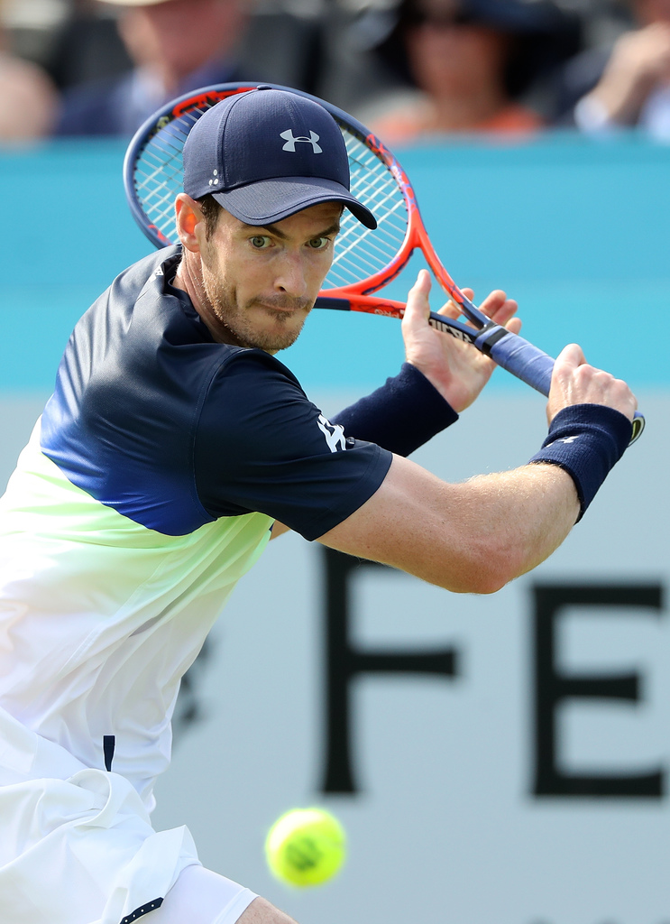
INTRODUCTION FOR PARENTS & CARERS (2)
COMPLETING THE CHALLENGES
First, look at the introductory presentation which sets the scene for the challenges, including the films. This will give you some useful background information about tennis, and about the key physical and character qualities which tennis players need.
You can do the five challenges whenever you want to, inside your home or in an outside space if you have one. For example, you might choose to do one a day for a week.
The challenges have been designed so that ideally, families can work through the activities together. However, children can also use them independently.
You don’t need any special equipment – some challenges need no equipment at all; others only whatever you can find around the home. Ideas are provided if you want to make the challenges harder, or you can think of your own
ways to take them further.
Each challenge focuses on one key character quality; however, children are encouraged to think about the other qualities which they might be using too. If doing
the challenges with other people, at the end of each
one there is the chance to ‘award’ someone who best demonstrated a key quality.
There is also a final ‘personal challenge’ which encourages children to develop a skill over the course of a week.

Slide 4
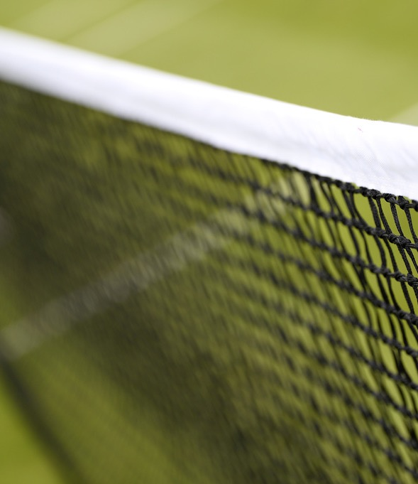

WARM-UP
Get started:
Can you spell the word NET using your body?
Can you do it only with particular parts of your body e.g. fingers, arms, feet?
Can you do it by mixing up parts of the body e.g. arms and feet; hands and legs?
Can you do it with different people in your family using a different part of their body?
Can you spell the whole word all together?
Today’s quality is PERSEVERANCE
Perseverance means when you keep on trying at something and don’t give up. Tennis players do this when they repeat and repeat skills, actions and routines over and over again.
Can you think of any times when you have persevered at something?

Slide 5
MAKE A TENNIS NET
Tips and ideas
Materials you can find around the home might be:
wool, thread or string
scrap paper
(like old envelopes or leaflets)
newspaper or card
crafty materials like lolly sticks or
pipe cleaners
twigs, sticks or long grass if you
have a garden
You’ll need glue or tape. You’ll also need:
scissors (with adult help if you need it)
ruler
Instructions
Tennis nets are 1.07 metres x 8.23 metres. That’s big!
Can you make a model tennis net using whatever you can find around the home?
The net must be at least 30cm x 50cm.
You can use glue or tape at the top of
your net.
When you’ve finished, try passing a ball across your net to a partner. How many times can you do it without stopping?

Slide 6
MAKE A TENNIS NET
When you’ve tried the challenge think about:
What helped you?
What didn’t help you?
How might you do it better?
Make the challenge harder!
Do the challenge again, but this time try these ideas:
Make the net bigger – how about 50cm x 50cm?
Make a few different-sized nets and join them together to make one long one.
Make a net using only one type of material, or only two.
Find the best combination of materials to make your net as sturdy as possible.
Make tennis nets and a ball to go with your net, and a tennis court too! Use these to play a mini game of tennis – does it work?

Slide 7
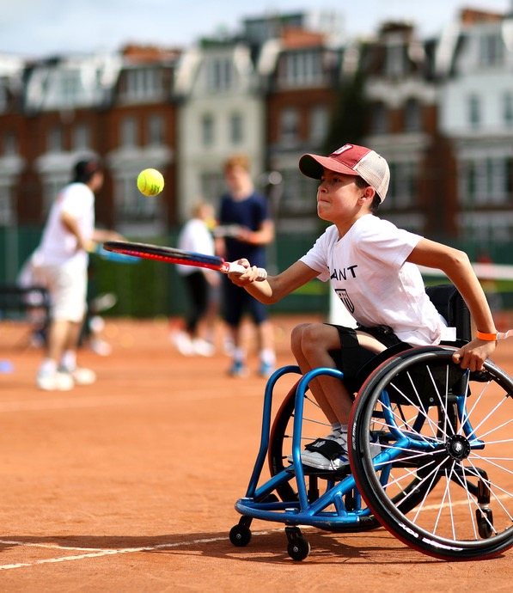
AND THE AWARD GOES TO…
Ask yourself…
How well did I do?
How well did everyone else do?
Did I persevere at the challenge?
And today’s award goes to…
Who wins the award for persevering when things got tough?
Did you or anybody else demonstrate any other key qualities? Resilience, motivation, passion, respect?
Afterwards…
Congratulate everyone (including yourself!) for something they did well.
Notice times when you or someone else is persevering at something challenging.

