Slide 1
TENNIS AT HOME
Personal development challenge 3

Slide 2
INTRODUCTION FOR PARENTS & CARERS (1)
DEVELOPING CHARACTER QUALITIES THROUGH TENNIS
The LTA Youth Schools programme is a suite of resources developed by the LTA to inspire the next generation of players and fans. These personal development activities were originally designed for teaching in lessons such as Personal, Social, Health and Economic (PSHE) Education, but have been adapted to support home learning.
This resource from the LTA gives children and their families information and activities to help them develop qualities and skills for personal development through five tennis-related challenges. The key character qualities are: resilience (which includes bouncing back); perseverance; motivation; passion (including enthusiasm) and respect. The challenges are designed for children in Key Stage 2 (Years 3-6) (Scotland: P4-7).
DEFINING THE KEY CHARACTER QUALITIES
Here are some ways to define the key character qualities. Children might have their own understanding of them too, especially after they have done the challenges:
Resilience: when you can ‘bounce back’ and get through something which has been difficult, or made you unhappy.
Perseverance: when you keep on trying at something and don’t give up.
Motivation: doing something because you want to, not because you are told to.
Passion: you have a very strong interest in something – you are excited and enthusiastic about it; you really love it!
Respect: thinking about how what you do or say might affect others; listening and appreciating who they are / what they do.

Slide 3
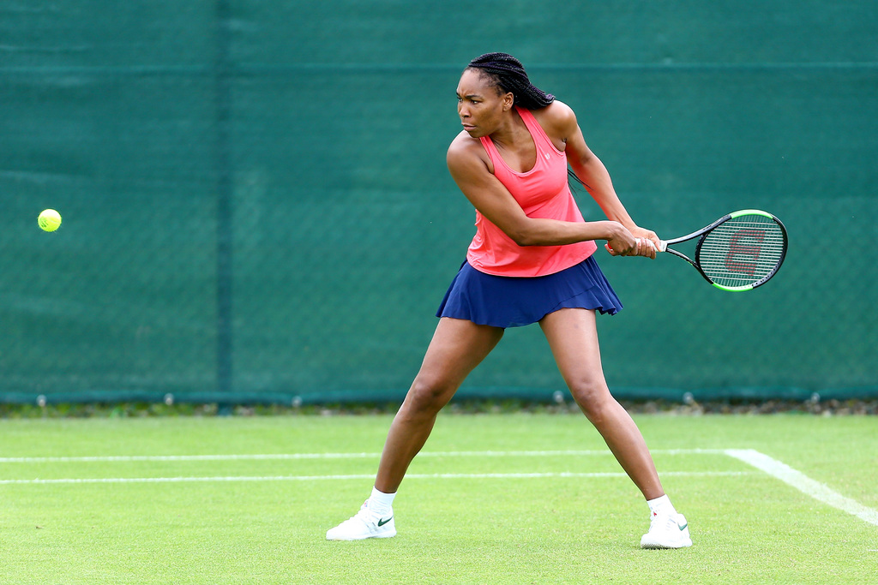
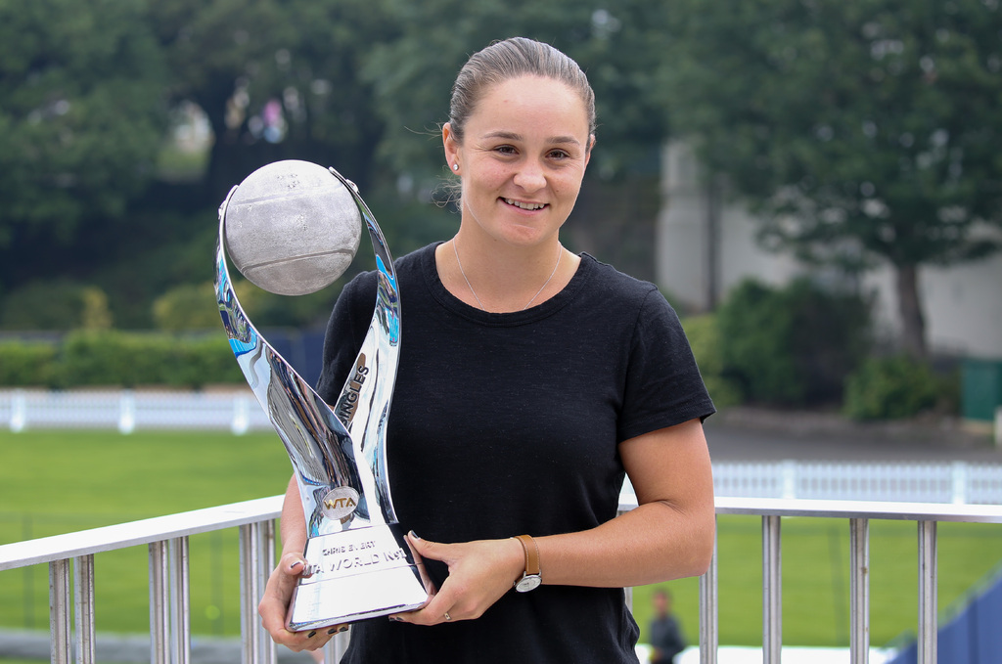
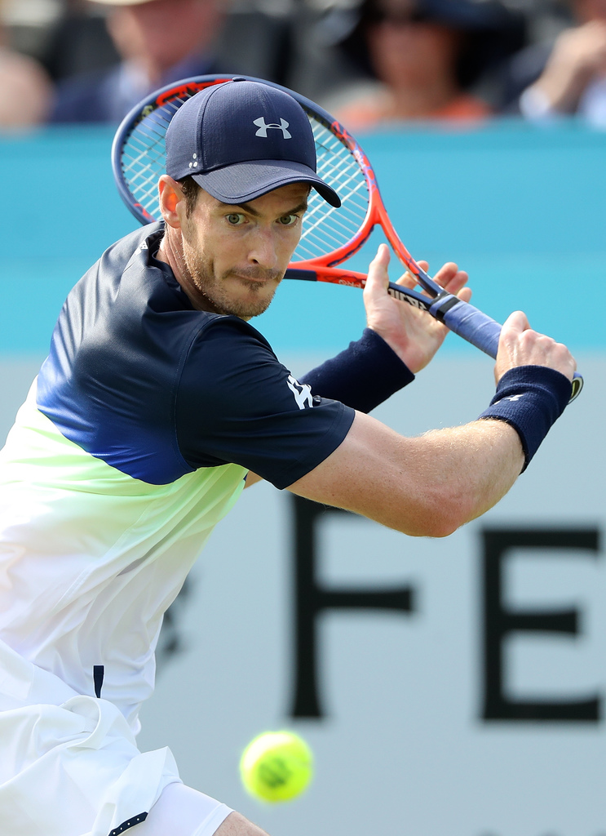
INTRODUCTION FOR PARENTS & CARERS (2)
COMPLETING THE CHALLENGES
First, look at the introductory presentation which sets the scene for the challenges, including the films. This will give you some useful background information about tennis, and about the key physical and character qualities which tennis players need.
You can do the five challenges whenever you want to, inside your home or in an outside space if you have one. For example, you might choose to do one a day for a week.
The challenges have been designed so that ideally, families can work through the activities together. However, children can also use them independently.
You don’t need any special equipment – some challenges need no equipment at all; others only whatever you can find around the home. Ideas are provided if you want to make the challenges harder, or you can think of your own
ways to take them further.
Each challenge focuses on one key character quality; however, children are encouraged to think about the other qualities which they might be using too. If doing
the challenges with other people, at the end of each
one there is the chance to ‘award’ someone who best demonstrated a key quality.
There is also a final ‘personal challenge’ which encourages children to develop a skill over the course of a week.

Slide 4
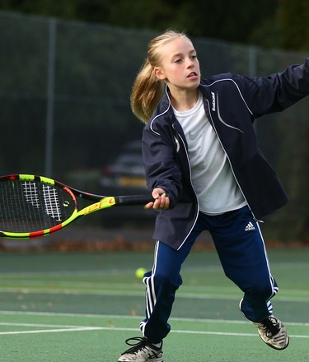
WARM-UP
Get started:
Start the slideshow. On the next slide, click to reveal the missing letters one at a time.
After each letter appears, see if you can predict what the phrase might say.
How many letters do you need to see before you know what it says?
Today’s quality is MOTIVATION
Motivation means doing something because you want to, not because you are told to.
What motivates you?
Tennis players are motivated because they want to play tennis and get better, even if it is difficult, or no-one is watching them. They are determined to do it.

Slide 5
WARM-UP
G
I
V
E
I
T
A
G
O

Slide 6
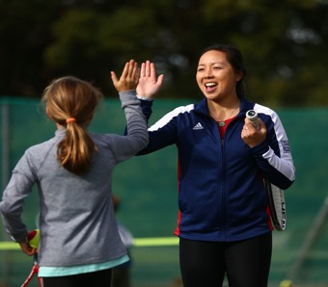
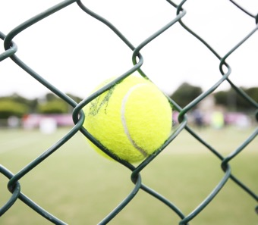
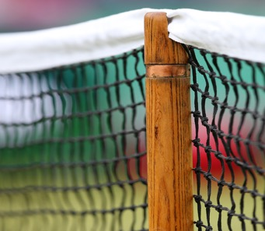
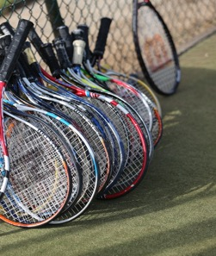
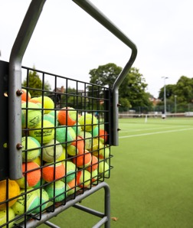
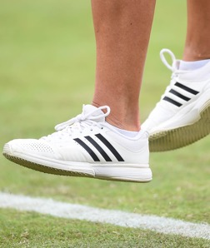
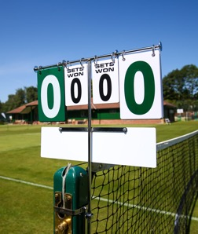
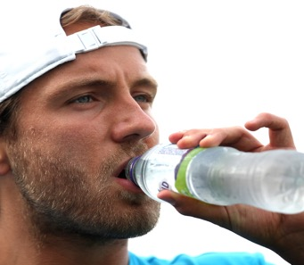
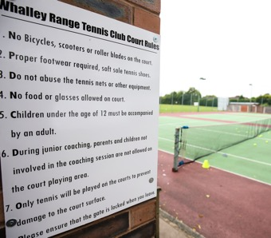
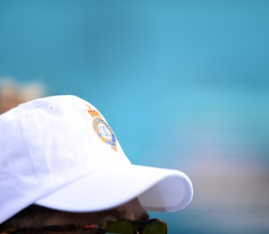
MEMORY GAME
Instructions
Click to reveal the images.
Give yourself 20 seconds to look at the pictures. Remember as many as you can.
Click again to make the images disappear.
Then time 60 seconds and write down all the pictures
you remember.

Slide 7
MEMORY GAME
When you’ve tried the challenge think about:
What helped you?
What didn’t help you?
How you could do it better next time?
Make the challenge harder!
Do the challenge again, but this time try these ideas:
Set yourself less time to look at and memorise the images (e.g. 15 or 10 seconds).
Instead of remembering just what is in the images, say what the items are used for as well.
Set up your own memory challenge using objects around the home. Set the objects up on a tray, then cover them up with a tea towel after 20 seconds. Each member of the family could take it in turns to choose different objects to memorise.

Slide 8
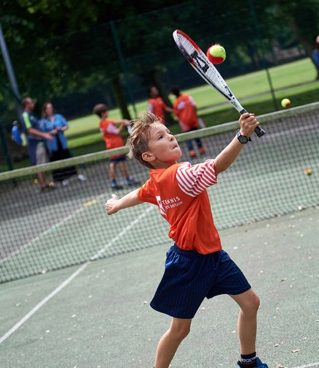
AND THE AWARD GOES TO…
Ask yourself…
How well did I do?
How well did everyone else do?
Was I motivated to complete the challenge?
And today’s award goes to…
Who wins the award for showing motivation when things got tough?
Did you or anybody else demonstrate any other key qualities?
Resilience, perseverance, passion, respect?
Afterwards…
Congratulate everyone (including yourself!) for something they did well.
Notice times when you or someone else is motivated to do something.

