Slide 1
TENNIS AT HOME
Personal development challenge 4

Slide 2
INTRODUCTION FOR PARENTS & CARERS (1)
DEVELOPING CHARACTER QUALITIES THROUGH TENNIS
The LTA Youth Schools programme is a suite of resources developed by the LTA to inspire the next generation of players and fans. These personal development activities were originally designed for teaching in lessons such as Personal, Social, Health and Economic (PSHE) Education, but have been adapted to support home learning.
This resource from the LTA gives children and their families information and activities to help them develop qualities and skills for personal development through five tennis-related challenges. The key character qualities are: resilience (which includes bouncing back); perseverance; motivation; passion (including enthusiasm) and respect. The challenges are designed for children in Key Stage 2 (Years 3-6) (Scotland: P4-7).
DEFINING THE KEY CHARACTER QUALITIES
Here are some ways to define the key character qualities. Children might have their own understanding of them too, especially after they have done the challenges:
Resilience: when you can ‘bounce back’ and get through something which has been difficult, or made you unhappy.
Perseverance: when you keep on trying at something and don’t give up.
Motivation: doing something because you want to, not because you are told to.
Passion: you have a very strong interest in something – you are excited and enthusiastic about it; you really love it!
Respect: thinking about how what you do or say might affect others; listening and appreciating who they are / what they do.

Slide 3
INTRODUCTION FOR PARENTS & CARERS (2)
COMPLETING THE CHALLENGES
First, look at the introductory presentation which sets the scene for the challenges, including the films. This will give you some useful background information about tennis, and about the key physical and character qualities which tennis players need.
You can do the five challenges whenever you want to, inside your home or in an outside space if you have one. For example, you might choose to do one a day for a week.
The challenges have been designed so that ideally, families can work through the activities together. However, children can also use them independently.
You don’t need any special equipment – some challenges need no equipment at all; others only whatever you can find around the home. Ideas are provided if you want to make the challenges harder, or you can think of your own ways to take them further.
Each challenge focuses on one key character quality; however, children are encouraged to think about the other qualities which they might be using too. If doing the challenges with other people, at the end of each one there is the chance to ‘award’ someone who best demonstrated a key quality.
There is also a final ‘personal challenge’ which encourages children to develop a skill over the course of a week.

Slide 4
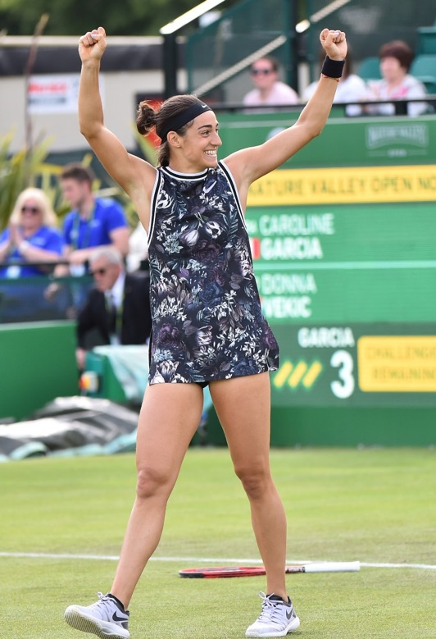
WARM-UP
Get started:
Think of something you’d like to celebrate! Is it someone’s birthday? Have you done something brilliant recently? Do you want to tell someone how fantastic you think they are? Or can you think of something you’ve clapped and cheered for before?
Decide what you’re celebrating and do some Mexican waves or big claps and cheers with your family. How does it make you feel when you’re all doing it together?
Today’s quality is PASSION
Passion means you have a very strong interest in something – you are excited and enthusiastic about it; you really love it! What are you passionate and enthusiastic about?
How do you know the tennis players in the pictures are passionate about their game?
Notes:
Players shown in the images (left-right)
Felix Auger Aliassime plays tennis for Canada. Aged 19 he was also ranked number 19 in the world. He started playing tennis aged five, and also plays the piano.
Caroline Garcia plays tennis for France. She is ranked number 47 in the world, and has won seven singles titles.
Niels Vink is a Dutch tennis player. At just 17 years old, he had won a number of tournaments, such as the British Open Wheelchair Tennis Championships.
Note: all player ages and rankings correct at time of publication.

Slide 5
ON BALANCE
Tips and ideas
If you don’t have a ball use anything round like an orange, a tin, a pencil pot or a plastic mug. (Make sure it’s something that won’t break if you drop it!)
If you have an outdoor space you might want to do this outside.
Instructions
The challenge is to move around a room or outside space with a ball or round object. Can you do it:
balancing the ball in different ways, e.g:
on something else (e.g. a racket or bat)
on the back of your hand
on your head
carrying the ball in different ways, e.g:
between your elbows
between your knees
between your fingers
passing the ball from one person to another so you’re both carrying or balancing it differently?

Slide 6
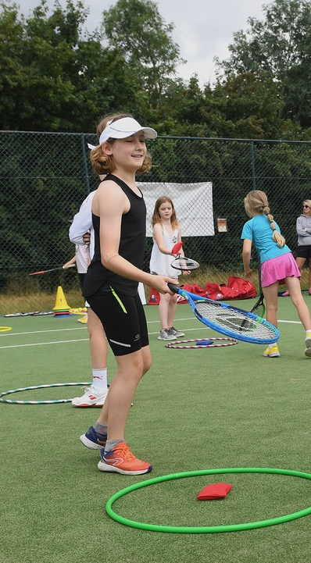
ON BALANCE
When you’ve tried the challenge think about:
What helped you?
What didn’t help you?
How could you do better next time?
Make the challenge harder!
Do the challenge again, but this time try these ideas:
Try balancing or carrying more than one ball (e.g. one on top of another).
If you have space, set up an obstacle course and see if you can get through it carrying the ball in different ways.
If you’ve got enough people for two small teams, set up a relay race where you all carry the ball differently and see which team finishes first, or without dropping the ball.

Slide 7
AND THE AWARD GOES TO…
Ask yourself…
How well did I do?
How well did everyone else do?
Did I show passion and enthusiasm?
And today’s award goes to…
Who wins the award for showing passion and enthusiasm for the challenge?
Did you or anybody else demonstrate any other key qualities? Resilience, perseverance, motivation, respect?
Afterwards…
Congratulate everyone (including yourself!) for something they did well.
Notice times when you or someone else is enthusiastic or passionate about something they do.

