Slide 1
TENNIS AT HOME
Personal development challenge 5

Slide 2
INTRODUCTION FOR PARENTS & CARERS (1)
DEVELOPING CHARACTER QUALITIES THROUGH TENNIS
The LTA Youth Schools programme is a suite of resources developed by the LTA to inspire the next generation of players and fans. These personal development activities were originally designed for teaching in lessons such as Personal, Social, Health and Economic (PSHE) Education, but have been adapted to support home learning.
This resource from the LTA gives children and their families information and activities to help them develop qualities and skills for personal development through five tennis-related challenges. The key character qualities are: resilience (which includes bouncing back); perseverance; motivation; passion (including enthusiasm) and respect. The challenges are designed for children in Key Stage 2 (Years 3-6) (Scotland: P4-7).
DEFINING THE KEY CHARACTER QUALITIES
Here are some ways to define the key character qualities. Children might have their own understanding of them too, especially after they have done the challenges:
Resilience: when you can ‘bounce back’ and get through something which has been difficult, or made you unhappy.
Perseverance: when you keep on trying at something and don’t give up.
Motivation: doing something because you want to, not because you are told to.
Passion: you have a very strong interest in something – you are excited and enthusiastic about it; you really love it!
Respect: thinking about how what you do or say might affect others; listening and appreciating who they are / what they do.

Slide 3
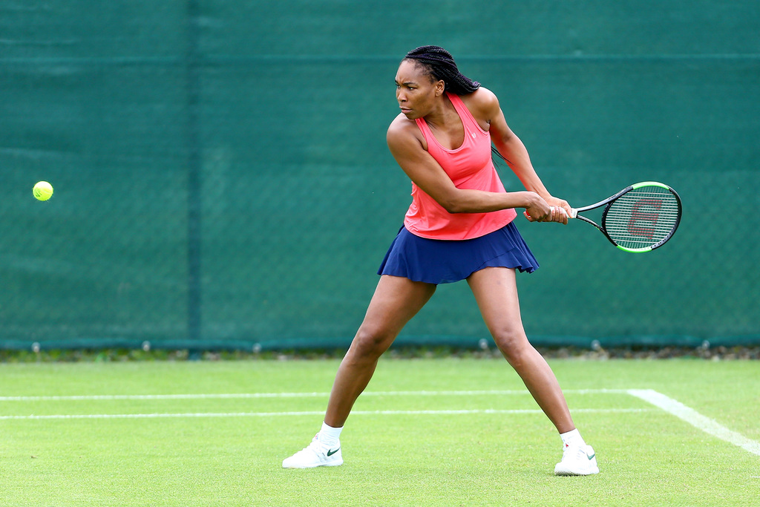
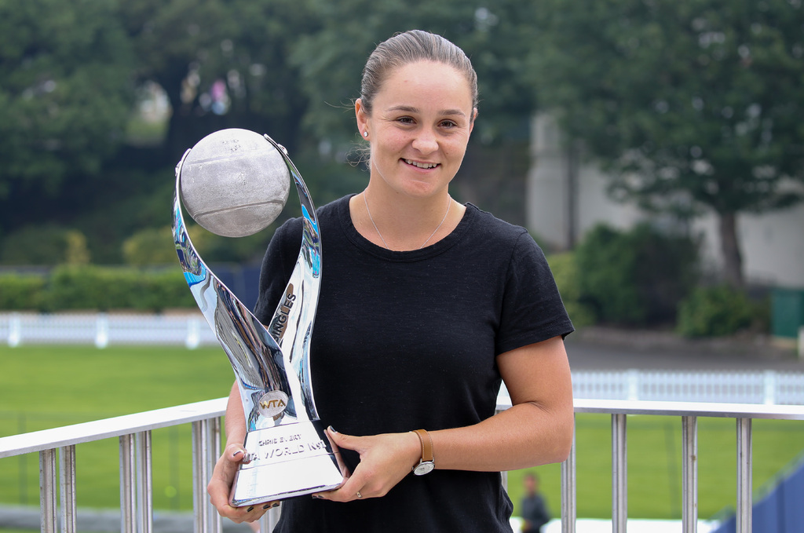
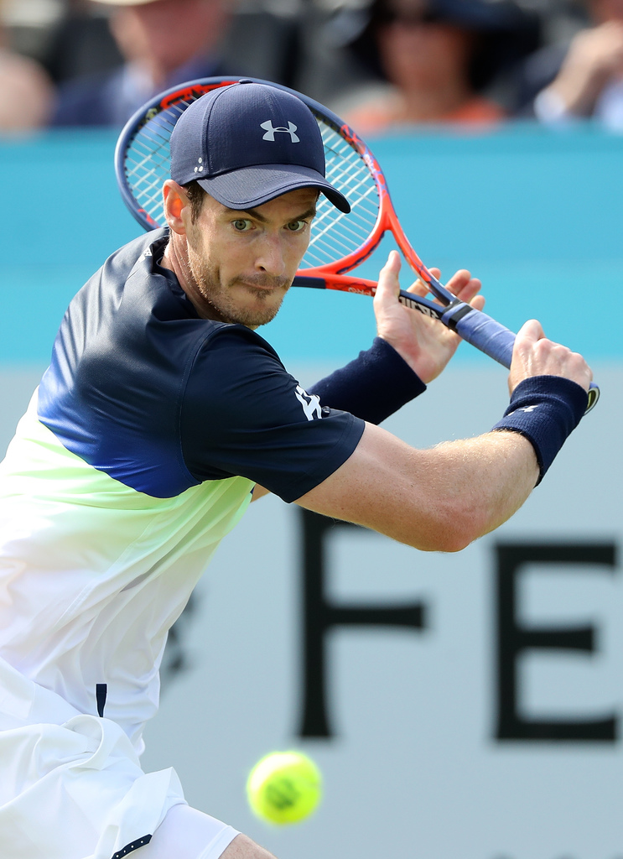
INTRODUCTION FOR PARENTS & CARERS (2)
COMPLETING THE CHALLENGES
First, look at the introductory presentation which sets the scene for the challenges, including the films. This will give you some useful background information about tennis, and about the key physical and character qualities which tennis players need.
You can do the five challenges whenever you want to, inside your home or in an outside space if you have one. For example, you might choose to do one a day for a week.
The challenges have been designed so that ideally, families can work through the activities together. However, children can also use them independently.
You don’t need any special equipment – some challenges need no equipment at all; others only whatever you can find around the home. Ideas are provided if you want to make the challenges harder, or you can think of your own
ways to take them further.
Each challenge focuses on one key character quality; however, children are encouraged to think about the other qualities which they might be using too. If doing
the challenges with other people, at the end of each
one there is the chance to ‘award’ someone who best demonstrated a key quality.
There is also a final ‘personal challenge’ which encourages children to develop a skill over the course of a week.

Slide 4
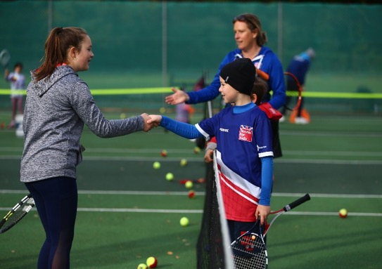
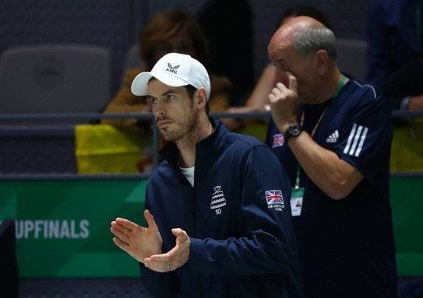
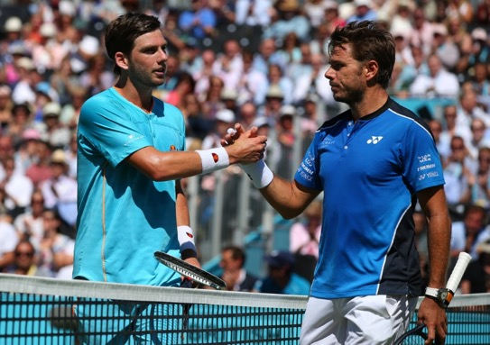
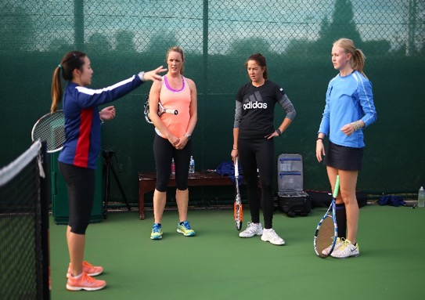
WARM-UP
Get started:
What are the players in the pictures doing?
What are they demonstrating towards other people?
Today’s quality is RESPECT
Respect means thinking about how what you do
or say might affect others; listening to others and appreciating who they are and what they do.
What are the different ways of showing someone respect?
Tennis players show respect by doing things such as shaking hands, saying, ‘well done’, congratulating one another, listening to the umpire, or clapping other players and spectators.

Slide 5

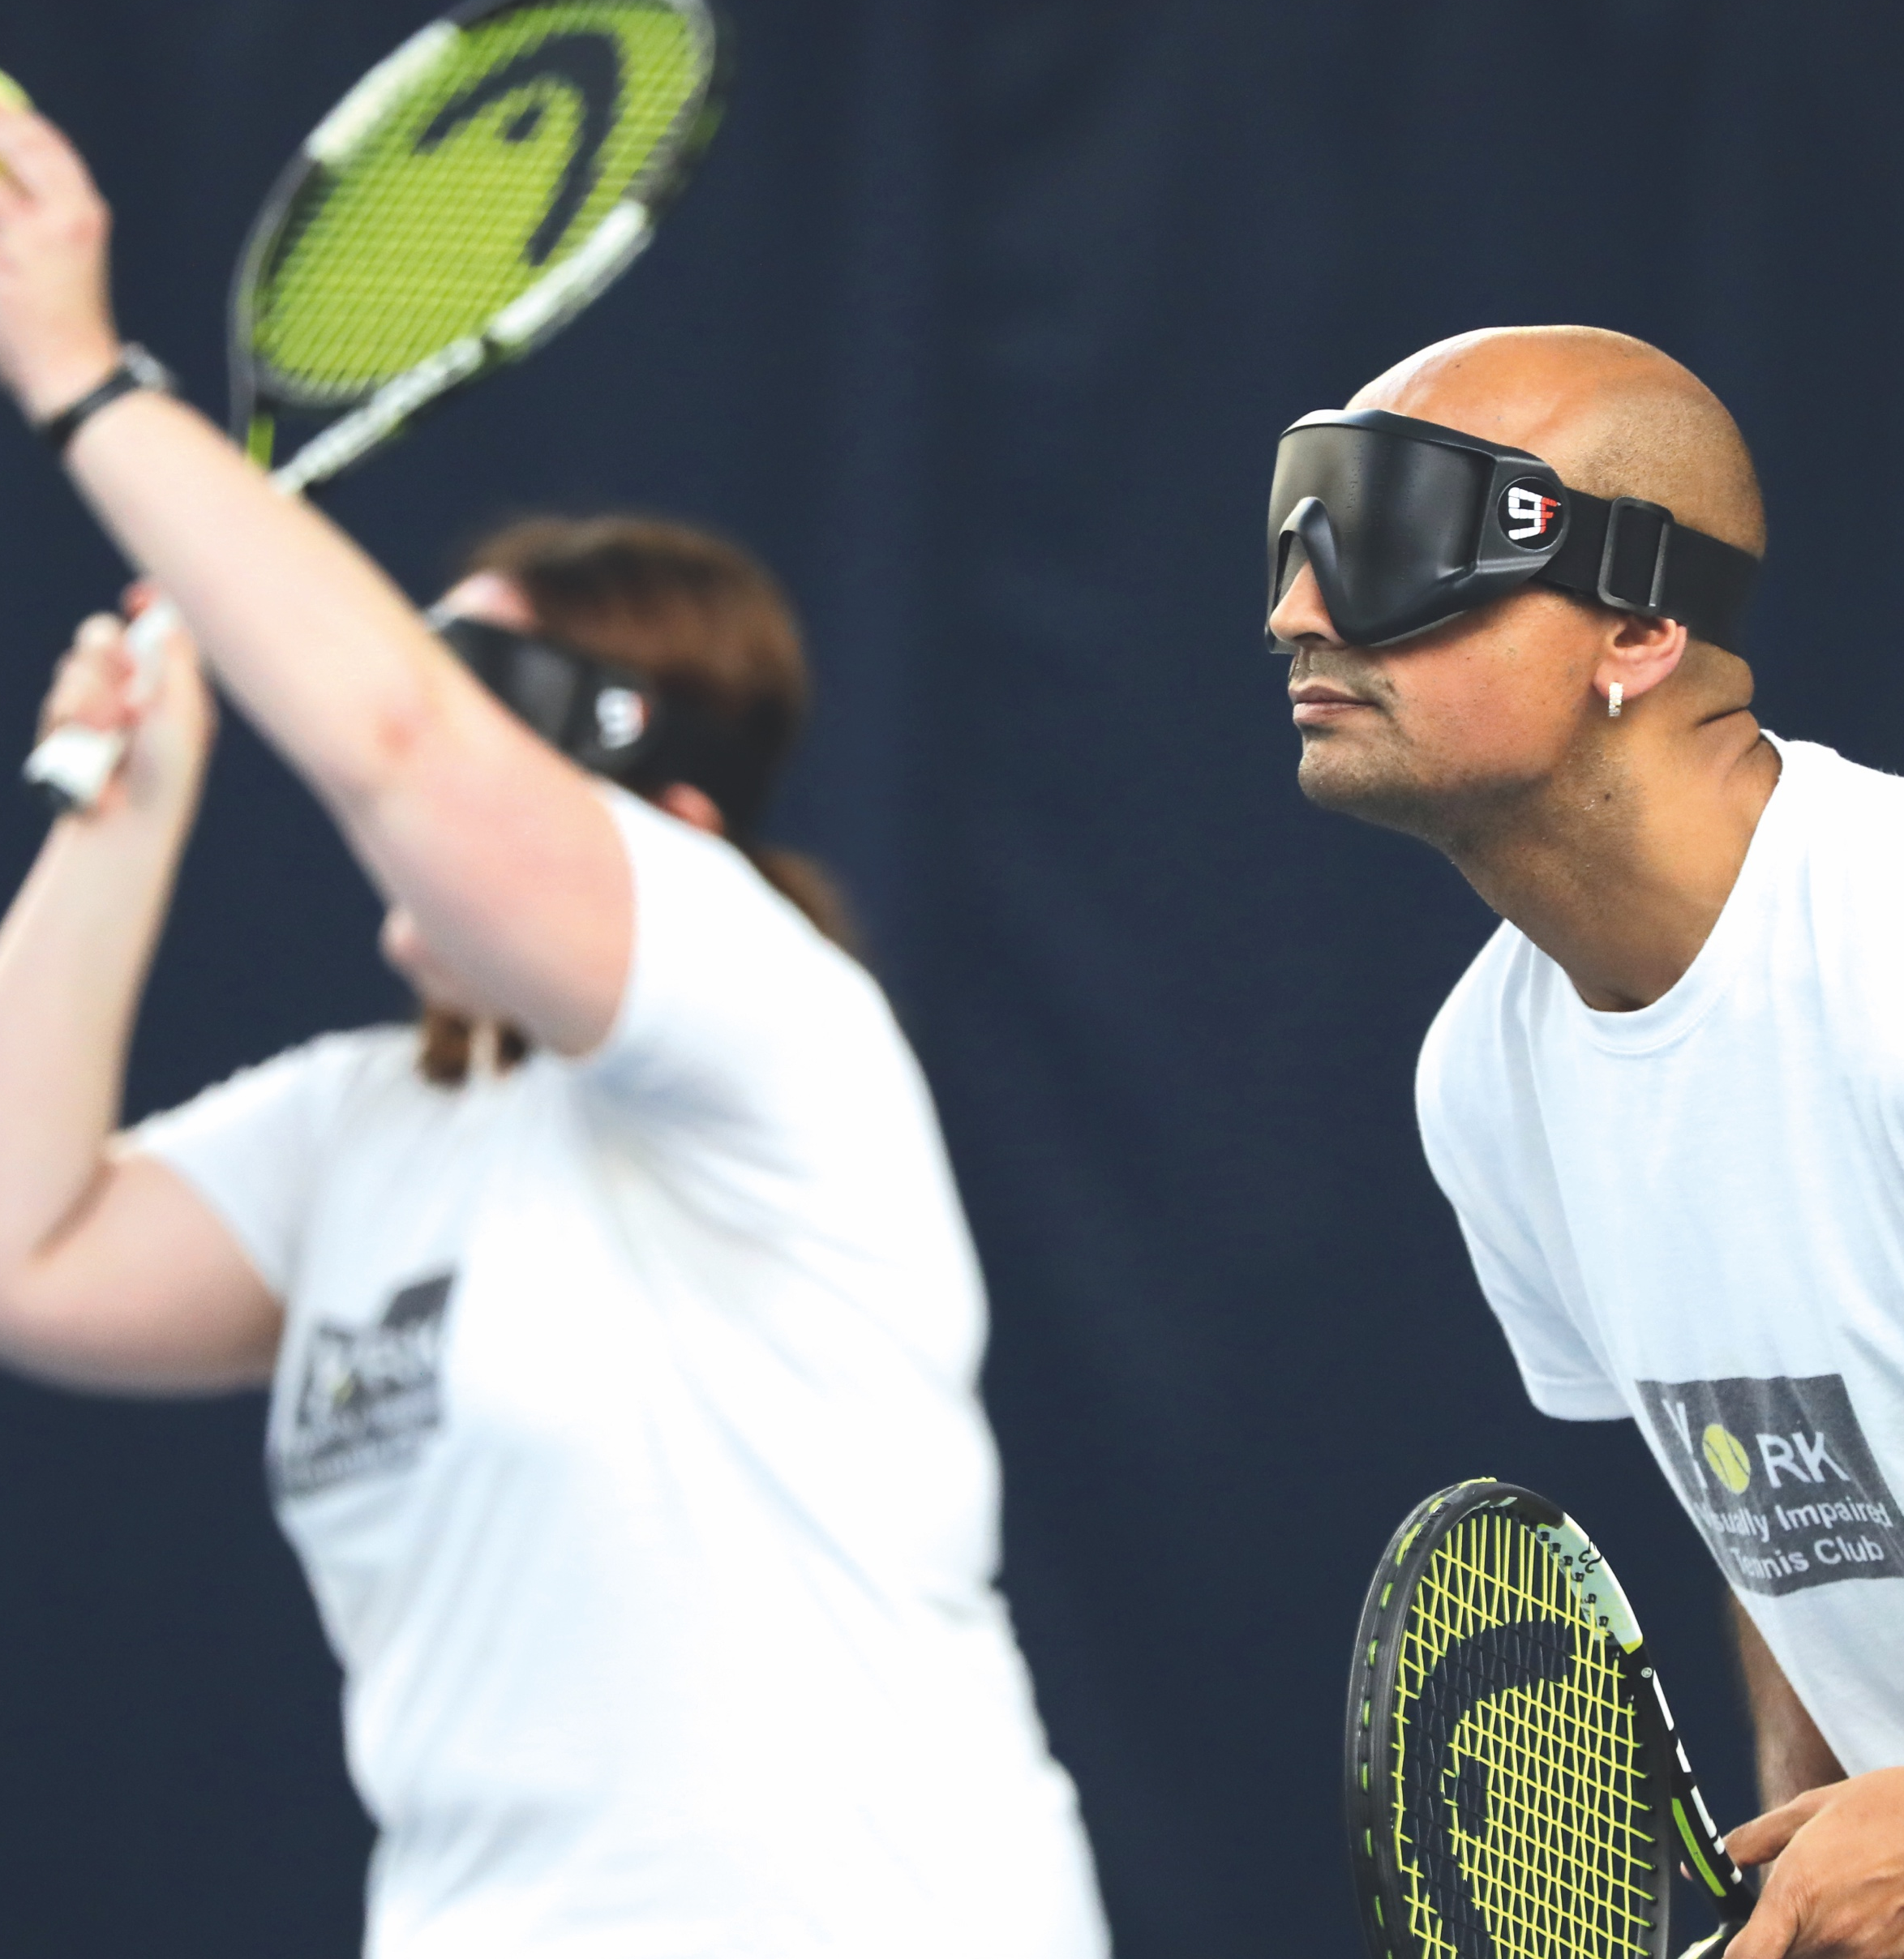
TENNIS FOR EVERYONE
Tips and ideas
This film showing blind and partially-sighted people playing tennis might help with your ideas.
Some of the things shown in
the film include:
special equipment e.g. an audible ball and
lower net
raised markings so players can feel them
eyeshades for everyone to wear
Instructions
Create a tennis game that people who are blind, partially-sighted
and sighted could play together.
The game must be fair for
everyone! Think about:
  equipment
  the court
  how to play
  how to score points and
  win the game
Present your game in whatever
way you like: a drawing, a set of instructions, a presentation or you could even make a film, animation
or computer programme.
Notes:
Film: https://vimeo.com/394164415/73a6a1e7d7

Slide 6
TENNIS FOR EVERYONE
When you’ve tried the challenge think about:
What helped you?
What didn’t help you?
Whether you could improve what you’ve done.
Make the challenge harder!
Do the challenge again, but this time try these ideas:
Are there any other team games that you could re-design so that people who are blind, partially-sighted and sighted can play together?
Can you design a game that people with and without other types of disability could play together?

Slide 7
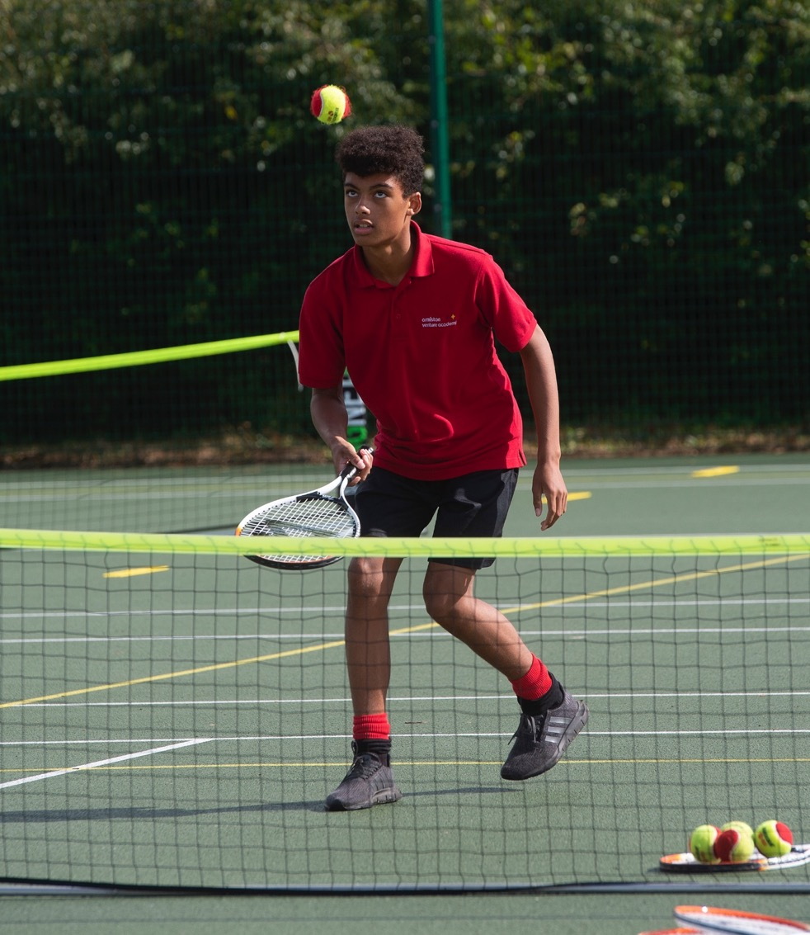
AND THE AWARD GOES TO…
Ask yourself…
How well did I do?
Is my game showing respect for everyone playing it?
And today’s award goes to…
If you’re designing your game with someone else, who wins the award for demonstrating respect?
Did you or anybody else demonstrate any other key qualities? Resilience, perseverance, motivation, passion?
Afterwards…
Congratulate everyone (including yourself!)
for something they did well.
Notice times when you or someone else
shows respect.

