Slide 1
CHALLENGE 1

Slide 2
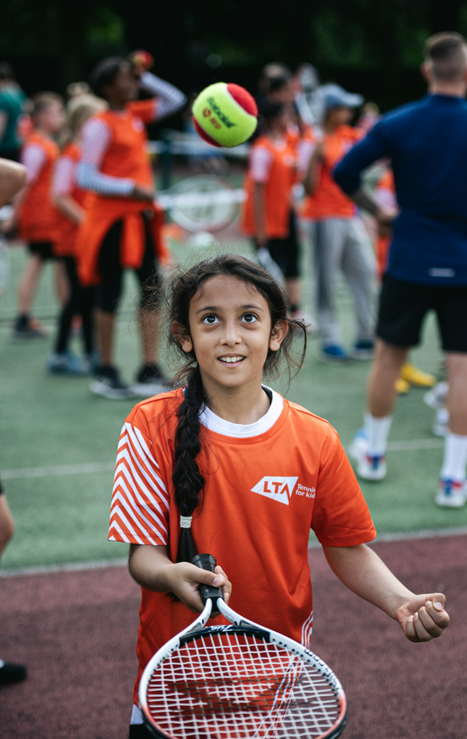
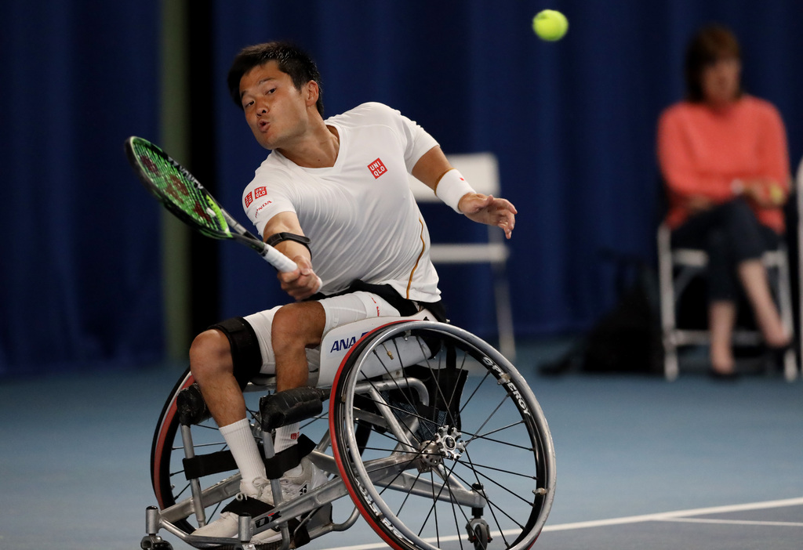
CHALLENGE 1
GET STARTED
Notes:
Teacher notes
Get started: As each picture is revealed ask pupils to copy the pose, holding it as still as possible for a few seconds.
Discussion:
Take a few moments to discuss the qualities that tennis players need in order to do well at their sport.
Include key physical and character qualities visible in the pictures and from the videos in Assembly 1.
Ask pupils how a player’s pose demonstrates or makes pupils think of that particular quality (e.g. facial expression, body shape etc.). For example, Physical: strength, power, flexibility, fitness, ability to run and move in different directions, balance, coordination, control, great reactions, speed, skilful etc. Character: passionate, motivated, enthusiastic, keen, committed, determined, involved, focused, persevering, respectful etc.
Professional players shown in the images are Shingo Kuneida and Venus Williams.
Shingo Kuneida is a wheelchair tennis player for Japan. He is currently ranked number 1 in the world, and has won 26 wheelchair grand slams, including nine at the Australian open. He has won three Olympic gold medals at London 2012, Beijing 2008 and Athens 2004.
Venus Williams plays tennis for the USA. She holds 49 singles titles, including five at Wimbledon and two at the US Open. With her sister Serena she holds 22 doubles titles and three Olympic gold medals.

Slide 3
CHALLENGE 1
WHICH QUALITIES?
Team instructions
On a large sheet of paper draw the outline of one person in your team.
Inside the body outline write or draw all the physical things involved in playing tennis. Be ready to explain your suggestions.
Outside the body write or draw all the other qualities you need to play tennis. Be ready to explain your suggestions.
11
Notes:
Teacher notes
This challenge links to Assembly 1.
Key character quality focus: introduces the key character qualities and gives pupils an opportunity to understand what they mean.
Learning outcomes
At the end of the task each pupil will be able to:
say how they and other team members contributed to the team challenge
identify the character qualities they and others demonstrated
discuss anything which didn’t work for the team.
Preparation: One large sheet of paper/card; writing/drawing/colouring materials; peer review cards (optional).
Space: Sufficient for one large sheet of paper per team to be laid on the floor.
During the challenge: As the challenge develops, prompt pupils to reflect as a team on:
what they should stop doing
what they should start doing
what they should continue doing, in order to complete the activity most effectively.
To make things easier: Pupils discuss and write a list of the physical and other qualities needed to play tennis.
To take the challenge further:
group the qualities into physical, mental and emotional
identify the factors that players are able to control and those that are external to their control
how might they manage the factors which are external to their control?

Slide 4
CHALLENGE 1
PEER REVIEW
encouraging
respectful
persevering
motivated
resilient
determined
passionate
kind
enthusiastic
positive
hard-working
motivating
team player
problem-solver
Notes:
Teacher notes
Discuss the physical and character qualities that make tennis players successful. Help pupils understand the key character qualities, and ways that tennis players demonstrate these.
Review: Teams reflect on their responses to the challenge using questions such as: What helped our team succeed? What prevented our team succeeding? How well did I personally respond to the challenge? What key character qualities did I bring to the team and how did these help the team succeed? Who in our team demonstrated which key qualities?
Introduce the words on the slide or use the Key character quality cards. Peer review the challenge by asking pupils to tell each other which key qualities they observed being demonstrated. Alternatively pupils can present team members with a relevant ‘key quality’ card. You may wish to add additional words or provide additional cards, or to or to challenge pupils to use the blank template to create their own Key character quality card.
Conclusion: Ask each team member to give an encouraging phrase to someone in the team about their involvement in the challenge, e.g. ‘Well done for trying’, ‘I liked the way you…’. Where possible encourage them to highlight any key character qualities they saw someone using, e.g. ‘You really showed perseverance when you...’
Beyond the challenge: Discuss with pupils times in or out of school when people may have to apply or demonstrate the key qualities. Are there any times when they have done so, or might need to in future?

